Slide 1

Algoritma Pemrograman Dasar :
Javascript
6
Day 7

Slide 2
1
Class
Outline Class
23
Object (OOP)

Slide 3
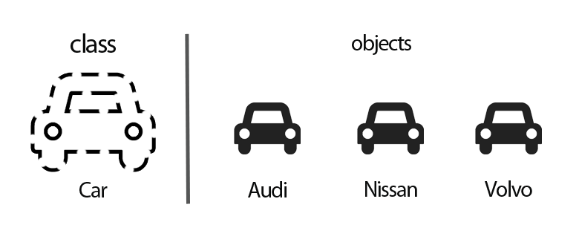
Class
Class is one of the new features introduced in javascript version 2015 or ES6.
A class is a blueprint for the object. You can create an object from the class.
You can think of the class as a sketch (prototype) of a house. It contains all the details about the floors, doors, windows, etc. Based on these descriptions, you build the house. House is the object.

Slide 4
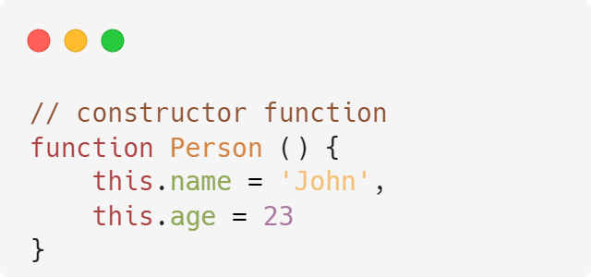
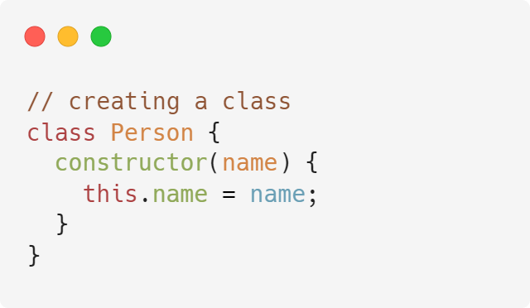
Syntax :
Note: When this is used with ES6 classes, it refers to the object inside which it is used .

Slide 5
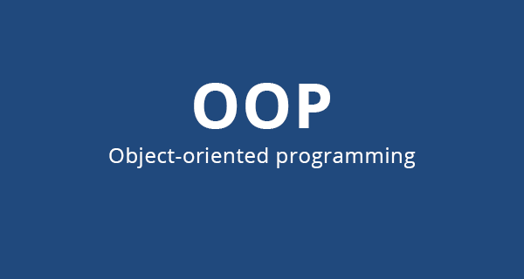
Object Oriented Programming
Object-oriented programming (OOP) is a computer programming model that organizes software design around data, or objects, rather than functions and logic

Slide 6
Access Modifiers
What are access modifiers?
Access modifier or visibility is a concept that is used to set the level of access to properties or methods in an object.
There are 2 access modifiers that we will study here, namely private and public.
Private is when the property or method can only be accessed or used within the function.
In other words, the object instance cannot use the property or method.
Public is when the property or method can be accessed from outside the function.

Slide 7
Object Oriented Programming
4 pillars of OOP :
Encapsulation
Inheritance
Polymorphism
Abstraction

Slide 8
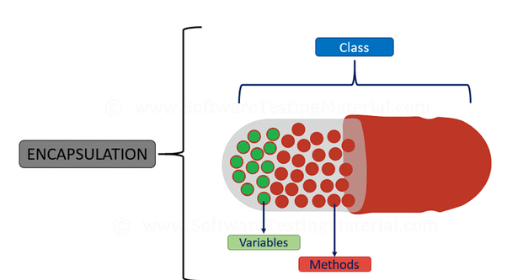
Encapsulation
Way to restrict direct access to properties or methods of an object.

Slide 9
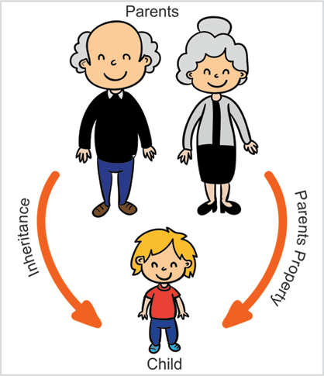
Inheritance
The process by which a class inherits its properties and methods to another class or its children.

Slide 10
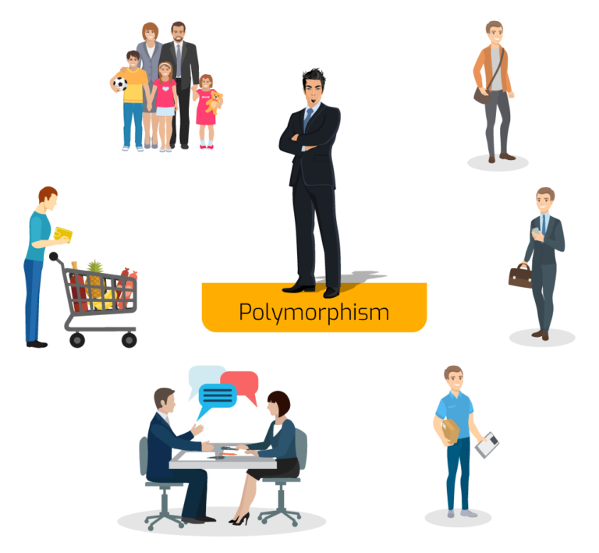
Polymorphism
The ability to create a variable, function, or object that has many forms.

Slide 11
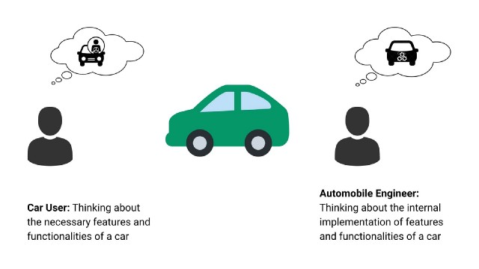
Abstraction
A technique for hiding certain details of an object and only showing the essential functionality or features of the object.

Slide 12
Thank you

